Slide 1
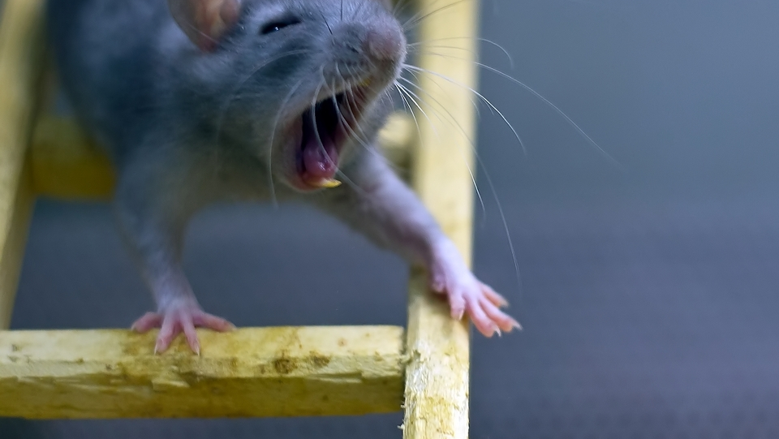
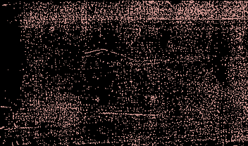
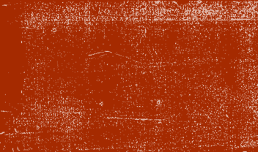
Blumpy The Rat
Team Shenanigames:
Michael Bell
GeonHui Yoon
Vladimir Moroz

Slide 2
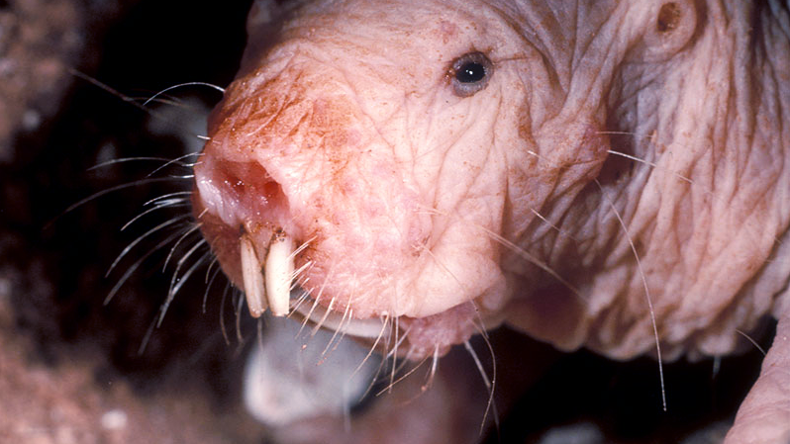
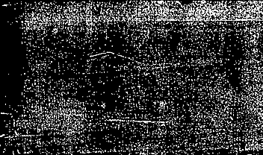

Contents
Work Distribution
Utilized Tools
Initial vs Final
Game Demo
Main challenges
Adjustments
Goals
Summary
References

Slide 3
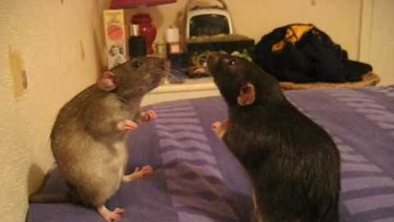
Work Distribution
Michael Bell Start Menu, music, art assets
Jamie Yoon Movement, collision, traps design
Vladimir Moroz Teleport Mechanic, level building

Slide 4
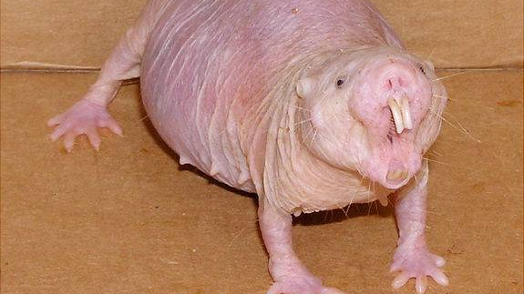
Tools
Unity
Trello
GitHub
Visual Studio

Slide 5
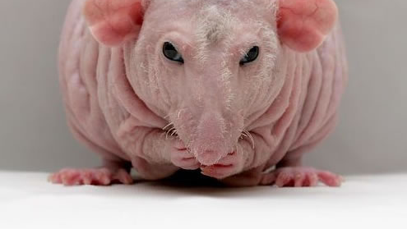
Initial concept
Final game
Game with 1 core build-around mechanic
Story is simple
Level design enables streamlined content production
Challenge-room based game
Simple teleporting mechanic (blumping)
Story is implied

Slide 6
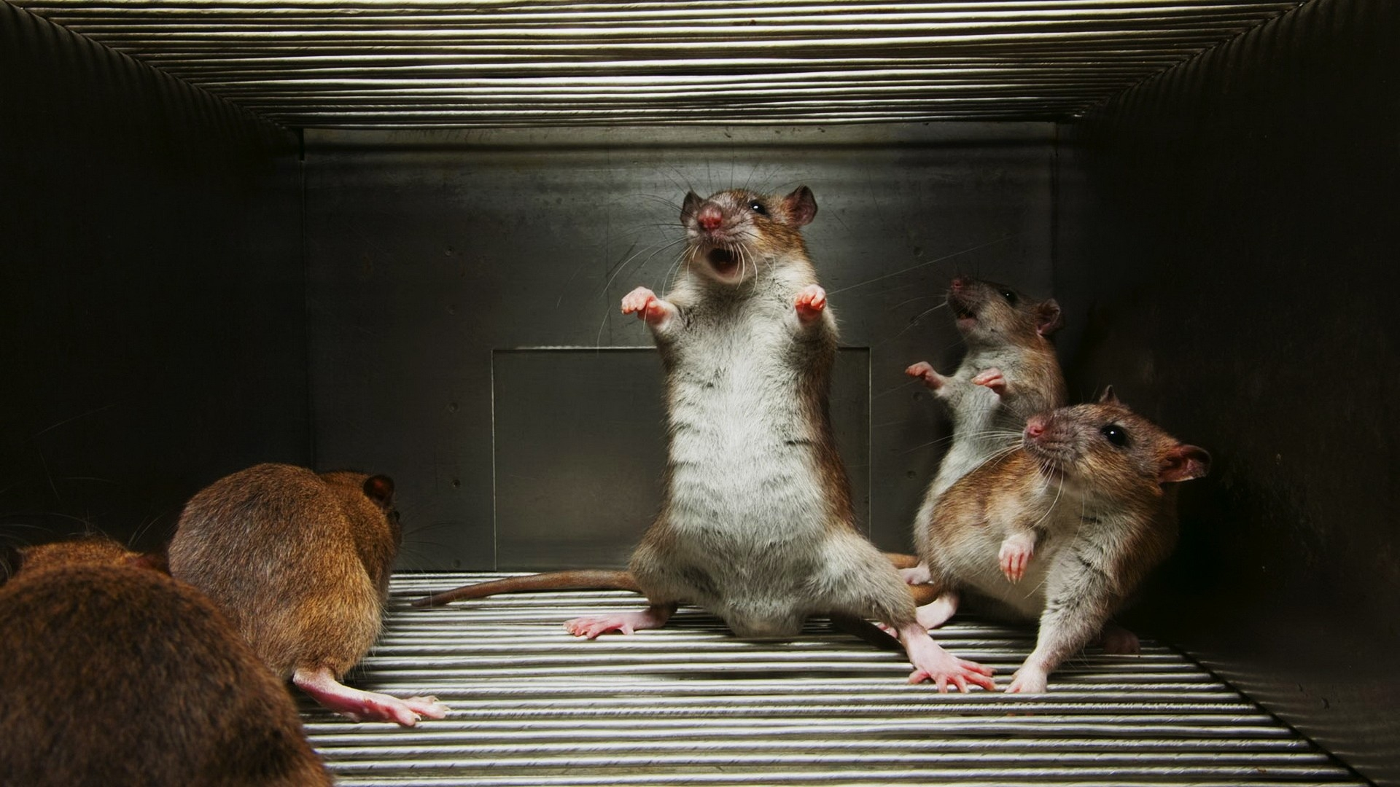
Main Challenges
Teleport mechanic
Movement and collision

Slide 7
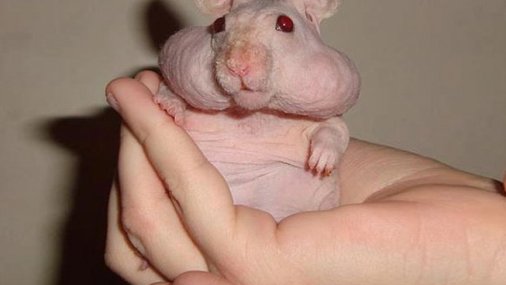
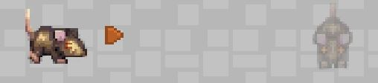
adjustments
Teleportation mechanic redesigned
Traps redesigned

Slide 8
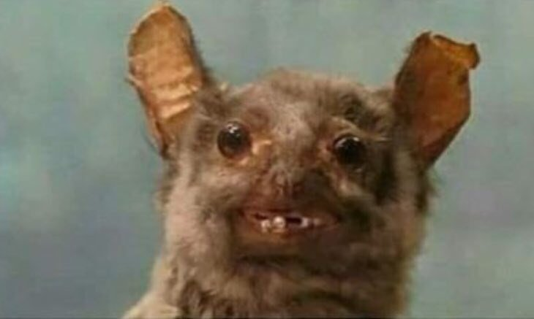
Goals
Reached
Solid teleport mechanic
Quick and precise level production
Original basic soundtrack
Not quite reached
In-depth story
Polished art design
Proper controller support
Database

Slide 9
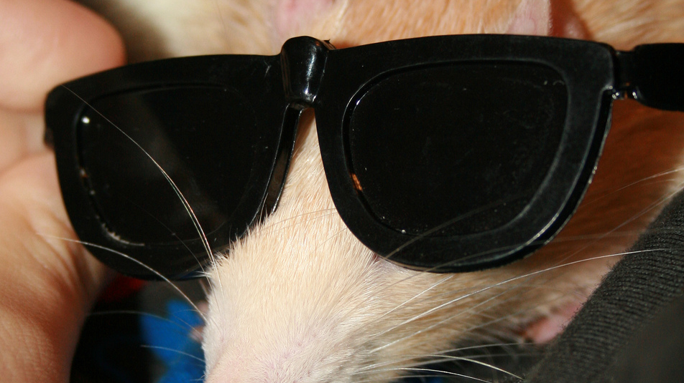
Summary
Room for improvement
Key goals achieved
Major learning experience

Slide 10
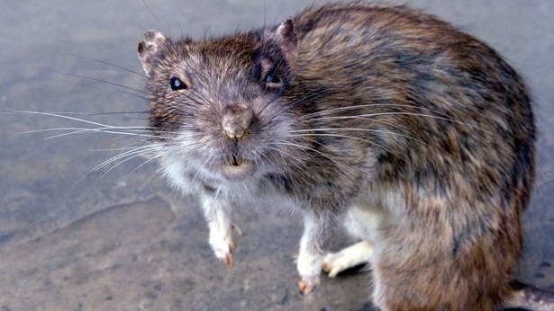
References
https://docs.unity3d.com/Manual/index.html
https://stackoverflow.com/
https://www.reddit.com/r/Unity3D/comments/1syswe/ps4_controller_map_for_unity/
YouTube Tutorials
https://www.youtube.com/playlist?list=PLiyfvmtjWC_X6e0EYLPczO9tNCkm2dzkm
https://www.youtube.com/watch?v=epZuI-YgXYo&t=522s
Sprites
https://forums.rpgmakerweb.com/index.php?threads/kazzadors-fantasy-sprites.683/
http://www.kenney.nl/assets/roguelike-rpg-pack

